Slide 1
CSE / T / 423C Distributed Computing Topic 5: Cloud Computing
Sarbani Roy
Department of Computer Science & Engineering
Jadavpur University E-mail: sarbani.roy@jadavpuruniversity.in
Room: CC-5-7
Phone: 9051639328

Slide 2
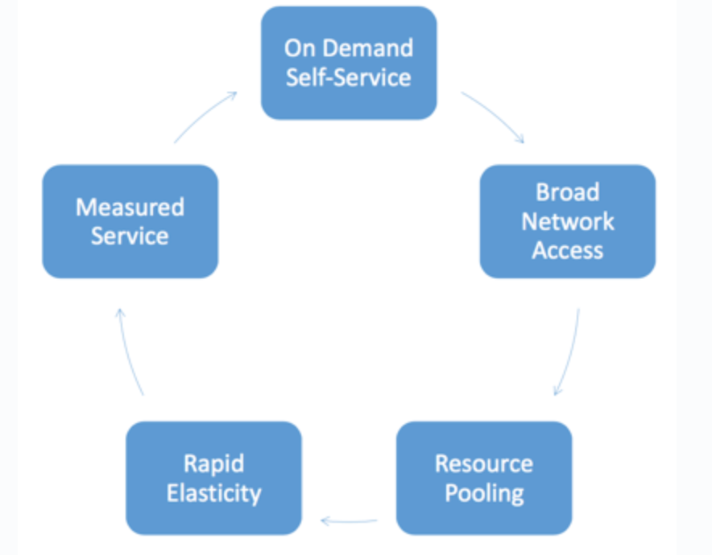
Cloud Computing
Cloud computing is a model for enabling ubiquitous, convenient, on-demand network access to a shared pool of configurable computing resources (e.g., networks, servers, storage, applications, and services) that can be rapidly provisioned and released with minimal management effort or service provider interaction.
https://nvlpubs.nist.gov/nistpubs/Legacy/SP/nistspecialpublication800-145.pdf

Slide 3
Features of Cloud Computing
Multi-tenancy
- Resources are shared among a large pool of users. This reduces Total Cost of Ownership(TCO) from providers point of view and Total Cost of Provisioning(TCP) from the users point of view
Agility
- Rapid and inexpensive re-provisioning of resources
Pervasive
- Accessing resources any time any where
Elastic
- Resources can be scaled up or scaled down on-demand
Pay-per-use
- Pay for resources per minute or per hour or per web request or per use of CPU cycles

Slide 4
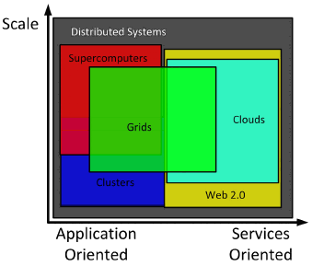
Evolution of Cloud Computing
Concept dating back to 1960’s by John McCarthy, a computer scientist, brought up the concept that “Computation may some day be organized as a public utility”.
Cloud computing turns computing into 5th utility after water, electricity, gas and telephony.
The evolution:
Cluster Computing
Grid Computing
Cloud Computing
Two key parameters:
Utilization of the resources
Flexibility of managing the resources

Slide 5
Capacity Vs Utilization
Cloud perspective

Slide 6
Traditional Infrastructure Model
Forecasted Infrastructure Demand
Capital
Time

Slide 7
Acceptable Surplus
Forecasted Infrastructure Demand
Surplus
Capital
Time

Slide 8
Real story
Actual Infrastructure Demand
Capital
Time

Slide 9
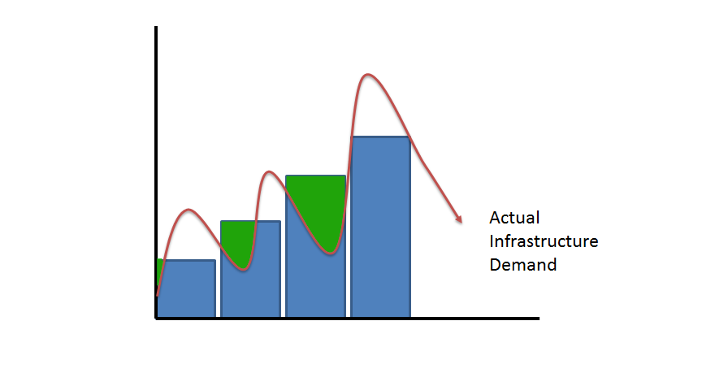
Unacceptable Surplus
Surplus
Capital
Time

Slide 10
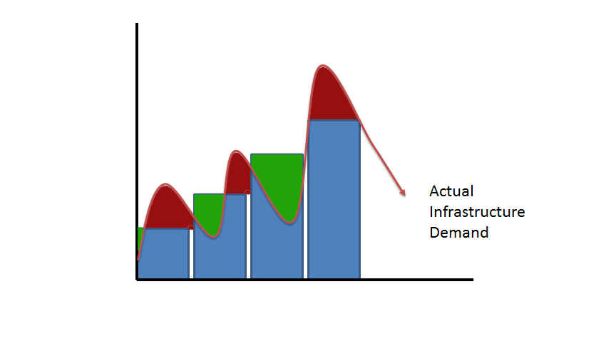
Unacceptable Deficit
Deficit
Capital
Time

Slide 11
Utility Infrastructure Model
Capital
Actual Infrastructure Demand
Time

Slide 12
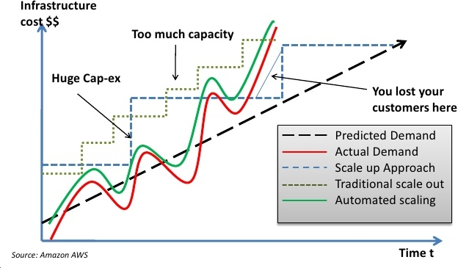
The Capacity versus Utilization Curve

Slide 13
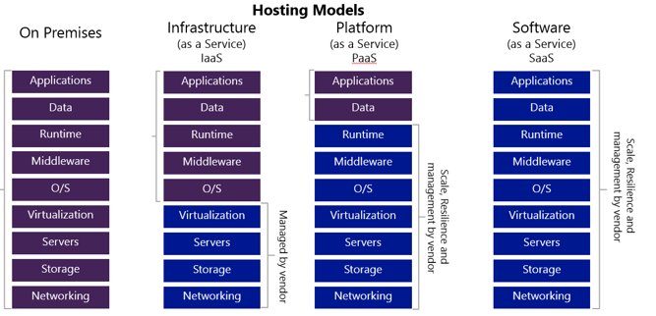
Everything as a Service

Slide 14
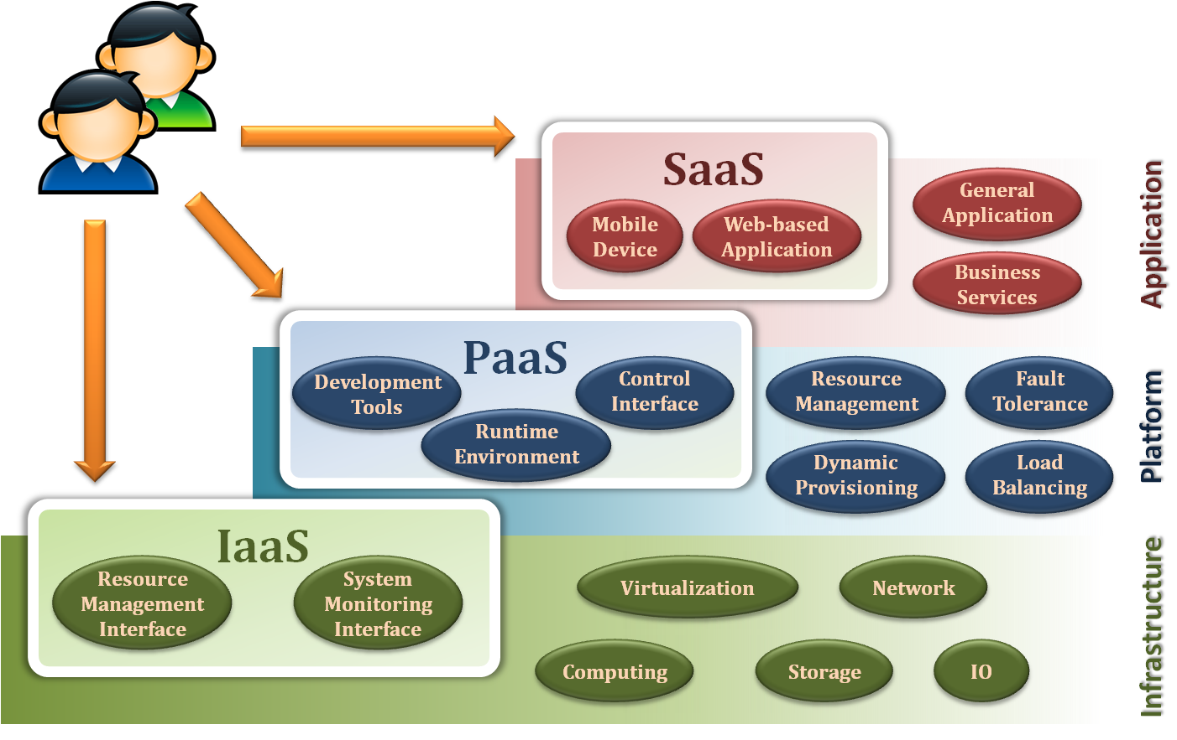
Service Model Overview

Slide 15
X as a Service
Terms that are used in this sphere include
Infrastructure as a Service (IaaS)
Providers manage virtualization, servers, hard drives, storage, and networking
Consumers are responsible for managing applications, data, runtime, middleware, and OS(s).
Example- Amazon Web Services , Microsoft Azure, Google Compute Engine etc.
Platform as a Service (PaaS)
Used for applications and other development
Provider can manage OS(s), middleware, virtualization, servers, storage, networking
Consumer (developer) manage the application only
Example- web sites, web applications, etc.
Software as a Service (SaaS)
Deliver applications to the consumer
Everything managed by provider- applications, runtime, data, middleware, OS(s), virtualization, server, storage, networking
Example- email and collaboration, customer relationship management etc.

Slide 16
Infrastructure as a Service
Provide service –Resource Management Interface
Several types of virtualized resource :
Virtual Machine – As an IaaS provider, we should be able to provide the basic virtual machine operations, such as creation, suspension, resumption and termination, …etc.
Virtual Storage – As an IaaS provider, we should be able to provide the basic virtual storage operations, such as space allocation, space release, data writing and data reading, …etc.
Virtual Network – As an IaaS provider, we should be able to provide the basic virtual network operations, such as IP address allocation, domain name register, connection establishment and bandwidth provision, …etc.

Slide 17
Infrastructure as a Service
Provide service – System Monitoring Interface
Several types of monitoring metrics :
Virtual Machine – As an IaaS provider, we should be able to monitor some system states of each virtual machine, such as CPU loading, memory utilization, IO loading and internal network loading, …etc.
Virtual Storage – As an IaaS provider, we should be able to monitor some storage states of each virtual storage, such as virtual space utilization, data duplication and storage device access bandwidth, …etc.
Virtual Network – As an IaaS provider, we should be able to monitor some network states of each virtual network, such as virtual network bandwidth, network connectivity and network load balancing, …etc.

Slide 18
IaaS - Summary
IaaS is the deployment platform that abstract the infrastructure.
IaaS enabling technique
Virtualization
Server Virtualization
Storage Virtualization
Network Virtualization
IaaS provided services
Resource Management Interface
System Monitoring Interface

Slide 19
Platform as a Service
Platform as a Service - PaaS
The capability provided to the consumer is to deploy onto the cloud infrastructure consumer-created or acquired applications created using programming languages and tools supported by the provider.
The consumer does not manage or control the underlying cloud infrastructure including network, servers, operating systems, or storage, but has control over the deployed applications and possibly application hosting environment configurations.

Slide 20
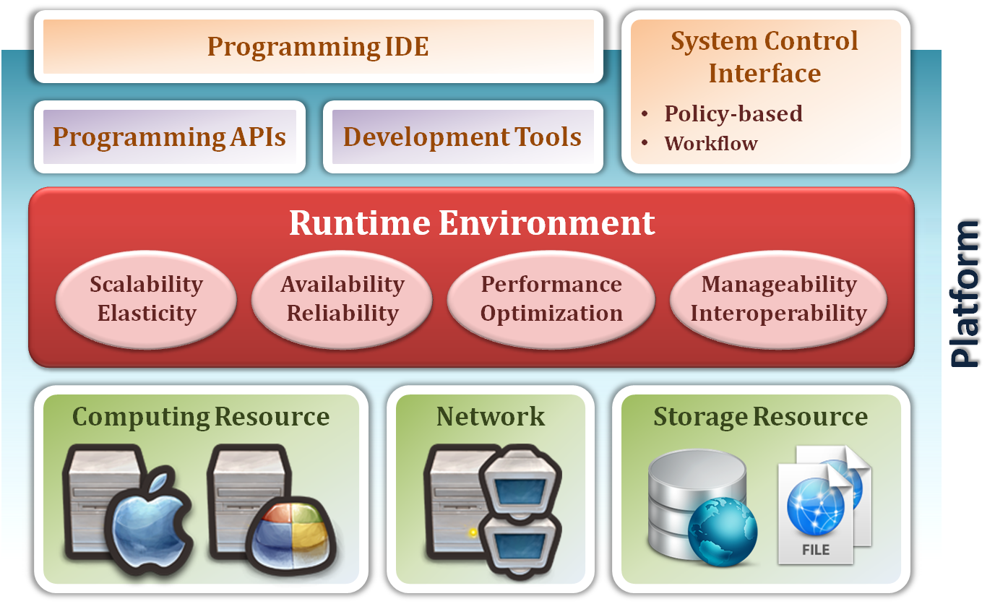
Platform as a Service
System architecture :

Slide 21
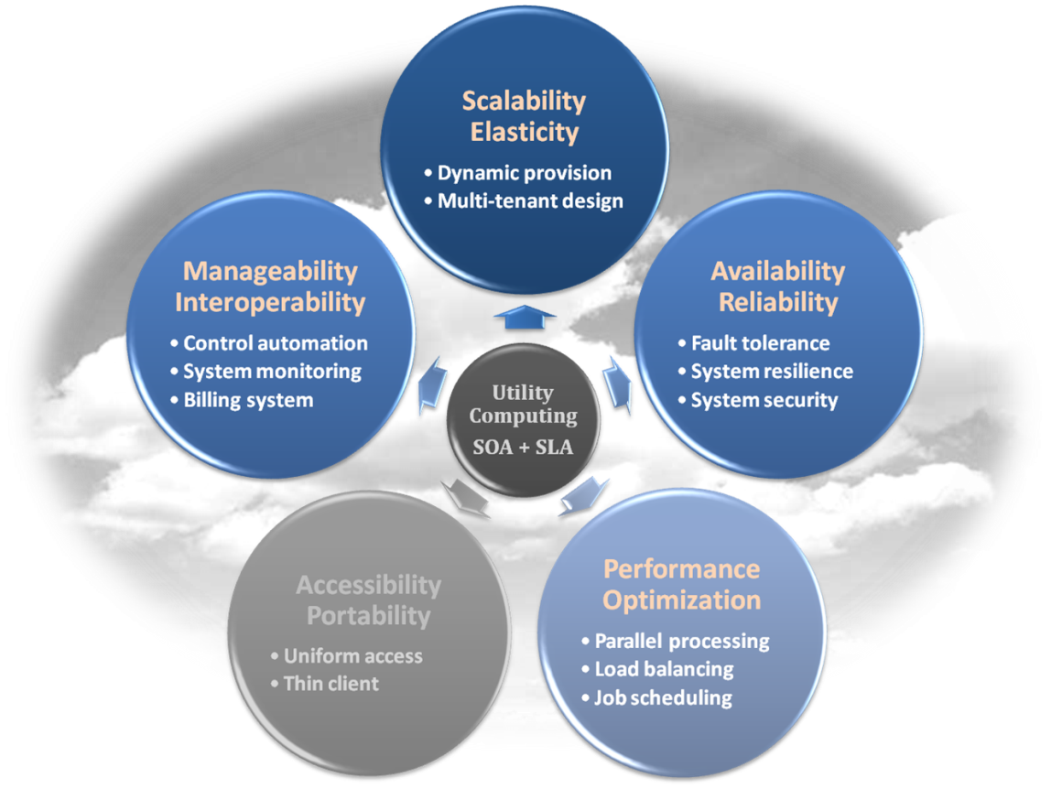
Platform as a Service
Enabling technique – Runtime Environment Design
Runtime environment refers to collection of software services available. Usually implemented by a collection of program libraries.
Common properties in Runtime Environment :
Manageability and Interoperability
Performance and Optimization
Availability and Reliability
Scalability and Elasticity

Slide 22
Platform as a Service
Provide service – Programming IDE
Users make use of programming IDE to develop their service among PaaS.
This IDE should integrate the full functionalities which supported from the underling runtime environment.
This IDE should also provide some development tools, such as profiler, debugger and testing environment.
The programming APIs supported from runtime environment may be various between different cloud providers, but there are still some common operating functions.
Computation, storage and communication resource operation

Slide 23
Platform as a Service
Provide service – System Control Interface
Police-Based Control
Typically described as a principle or rule to guide decisions and achieve rational outcome(s)
Make the decision according to some requirements
Workflow Control
Describe the flow of installation and configuration of resources
Workflow processing daemon delivers speedy and efficient construction and management of cloud resources

Slide 24
PaaS - Summary
PaaS is the development platform that abstract the infrastructure, OS, and middleware to drive developer productivity.
PaaS enabling technique
Runtime Environment
PaaS provide services
Programming IDE
Programming APIs
Development tools
System Control Interface
Policy based approach
Workflow based approach

Slide 25
Software as a Service
Software as a Service - SaaS
The capability provided to the consumer is to use the provider’s applications running on a cloud infrastructure. The applications are accessible from various client devices through a thin client interface such as a web browser (e.g., web-based email).
The consumer does not manage or control the underlying cloud infrastructure including network, servers, operating systems, storage, or even individual application capabilities, with the possible exception of limited user-specific application configuration settings.

Slide 26
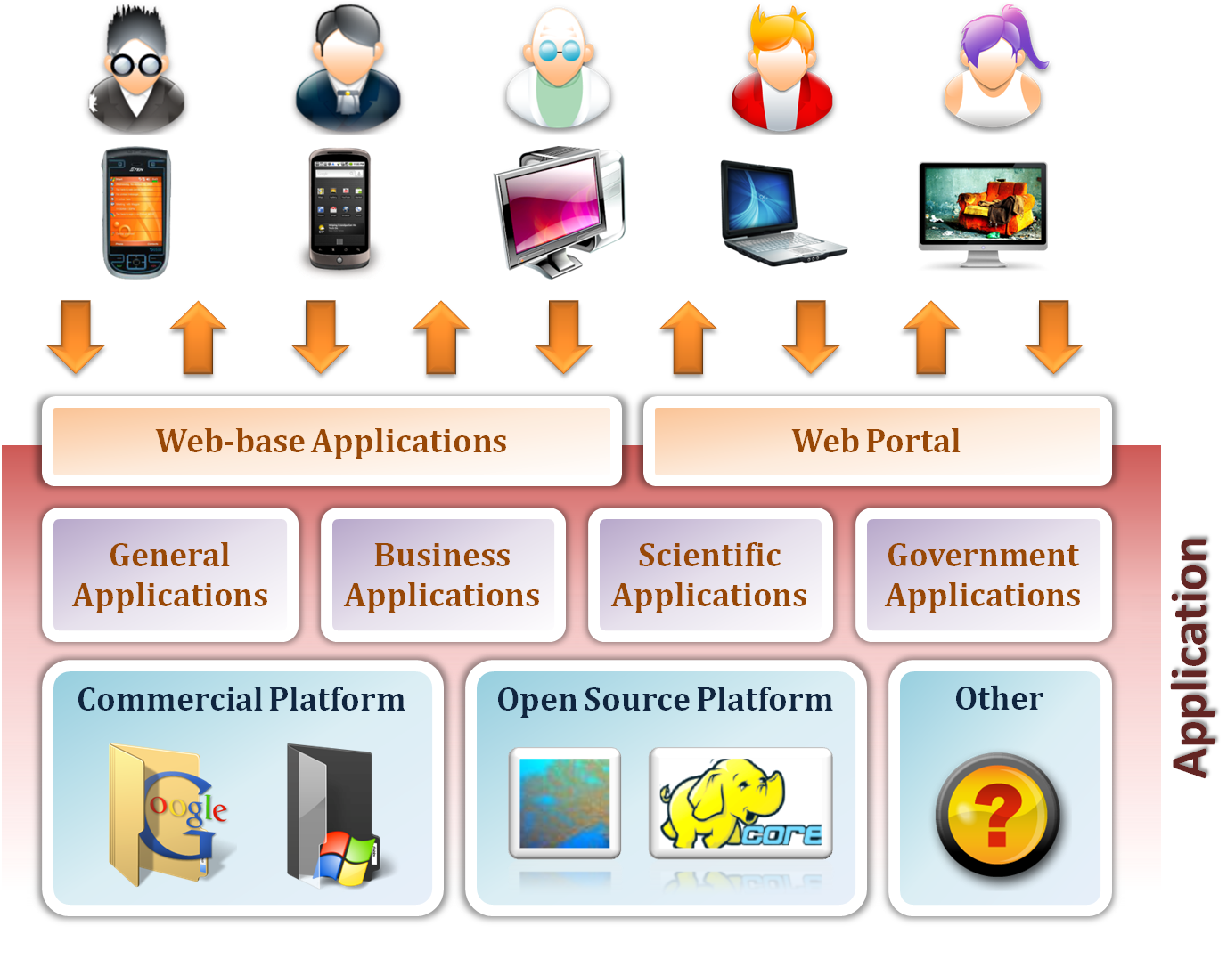
Software as a Service

Slide 27
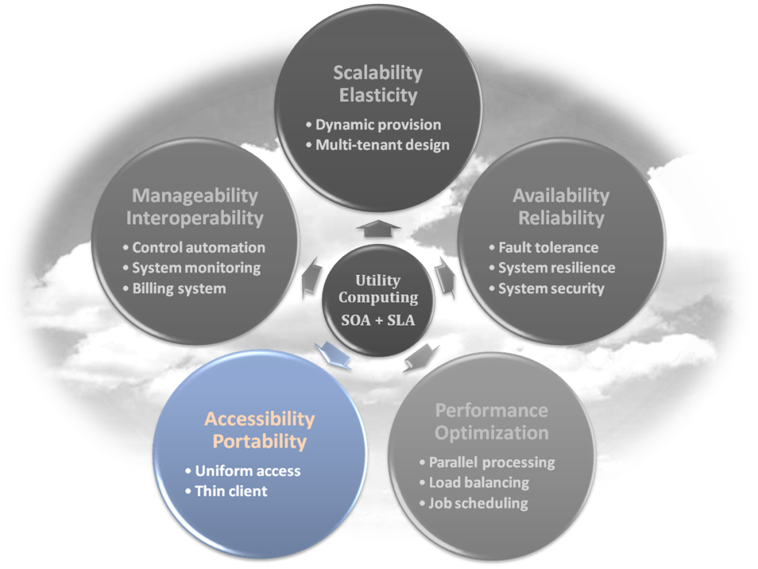
Software as a Service
Enabling Technique – Web Service
Web 2.0 is the trend of using the full potential of the web
Viewing the Internet as a computing platform
Running interactive applications through a web browser
Leveraging interconnectivity and mobility of devices
Enhanced effectiveness with greater human participation
Properties provided by Internet :
Accessibility and Portability

Slide 28
Software as a Service
Provide service – Web-based Applications
Conventional applications should translate their access interface onto web-based platform.
Applications in different domains
General Applications – Applications which are designed for general propose, such as office suit, multimedia and instant message, …etc.
Business Applications – Application which are designed for business propose, such as ERP, CRM and market trading system, …etc.
Scientific Applications – Application which are designed for scientific propose, such as aerospace simulation and biochemistry simulation, …etc.
Government Applications – Applications which are designed for government propose, such as national medical system and public transportation system service, …etc.

Slide 29
Software as a Service
Provide service – Web Portal
Apart from the standard search engine feature, web portals offer other services such as e-mail, news, stock prices, information, databases and entertainment.
Portals provide a way for enterprises to provide a consistent look and feel with access control and procedures for multiple applications and databases, which otherwise would have been different entities altogether.

Slide 30
SaaS - Summary
SaaS is the finished applications that you rent and customize.
SaaS enabling technique
Web Service
SaaS provide services
Web-based Applications
General applications
Business applications
Scientific applications
Government applications
Web Portal

Slide 31
Deployment models
Private cloud: It’s mine, all mine, and not yours. The private cloud is used exclusively by one user.
Community cloud: It’s yours and mine, but not his, because he isn’t one of us. Meaning the cloud is used exclusively by a group of people or a community.
Public cloud: It’s yours, mine, his, and anyone else who is willing to pay for it. Used openly by the general public.
Hybrid cloud: This part is yours, and that part is mine, and we will connect them together in some way. It’s made up of two or more deployment models (private, community and public) within the same organization.
http://csrc.nist.gov/publications/nistpubs/800-145/SP800-145.pdf.

Slide 32
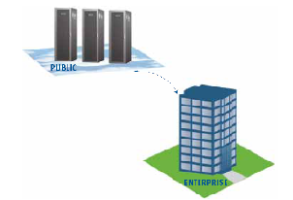
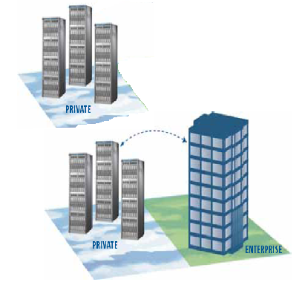
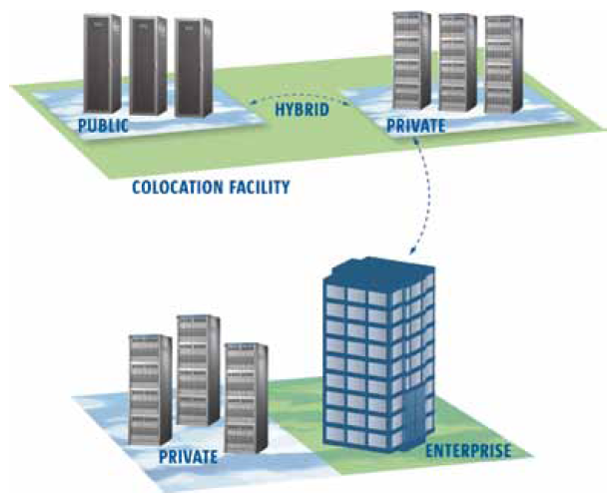
Cloud Deployment Models
Public Cloud
Private Cloud
Community Cloud
Hybrid Cloud
Heterogeneous Cloud(Sky Computing)
Notes:
You can deploy your application using the following five cloud deployment models.
In a public cloud you can deploy your application within vms launched within the datacenter of a public provider. The feature is that the physical system where your vm is running may be shared by the vms from public.
With private cloud you can deploy your application within a public provider’s datacenter or within your own datacenter. For the first one, the physical system of the public provider where your vms are running will not be shared by others.
Community cloud lies in between public and private. Here the physical systems are not shared by the public and not given in lease to you rather may be shared by a community.
With hybrid cloud you can deploy your application partly in private cloud and the remaining in public cloud. This kind of deployment will help you to decide between security and cost.
Heterogeneous cloud is a special kind of public cloud where you can deploy your application within a number of heterogeneous public cloud provider’s datacenters. Since such a deployment forms a cloud of clouds, sometimes its called sky computing.

Slide 33
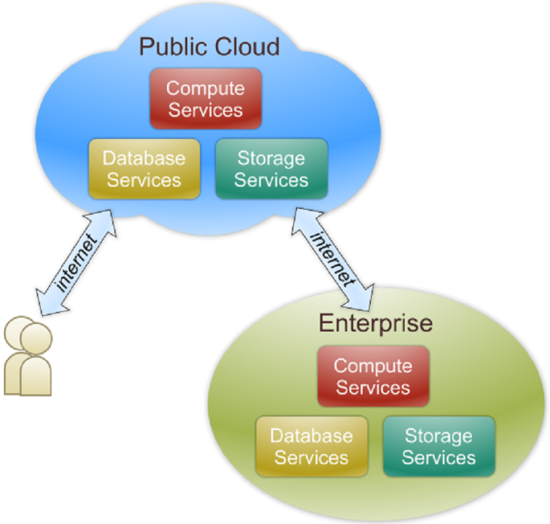
Public Cloud
Public cloud definition
The cloud infrastructure is made available to the general public or a large industry group and is owned by an organization selling cloud services.
Also known as external cloud or multi-tenant cloud, this model essentially represents a cloud environment that is openly accessible.
Basic characteristics :
Homogeneous infrastructure
Common policies
Shared resources and multi-tenant
Leased or rented infrastructure
Economies of scale

Slide 34
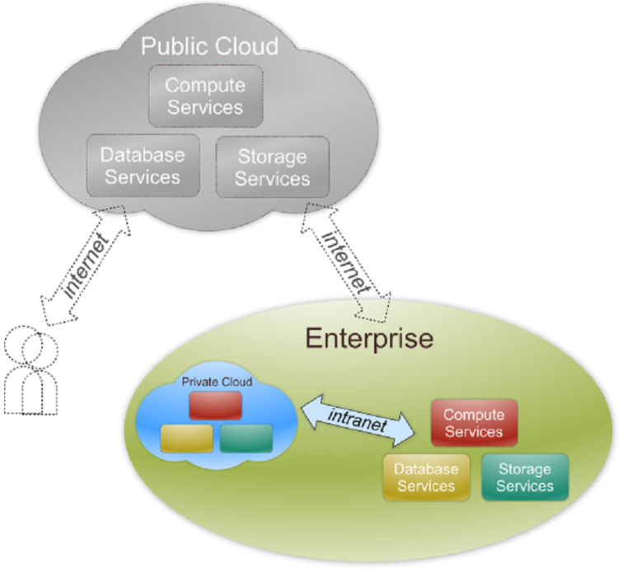
Private Cloud
Private cloud definition
The cloud infrastructure is operated solely for an organization. It may be managed by the organization or a third party and may exist on premise or off premise.
Also referred to as internal cloud or on-premise cloud, a private cloud intentionally limits access to its resources to service consumers that belong to the same organization that owns the cloud.
Basic characteristics :
Heterogeneous infrastructure
Customized and tailored policies
Dedicated resources
In-house infrastructure
End-to-end control

Slide 35
Public vs. Private
Comparison :
 | Public Cloud | Private Cloud
Infrastructure | Homogeneous | Heterogeneous
Policy Model | Common defined | Customized & Tailored
Resource Model | Shared & Multi-tenant | Dedicated
Cost Model | Operational expenditure | Capital expenditure
Economy Model | Large economy of scale | End-to-end control

Slide 36
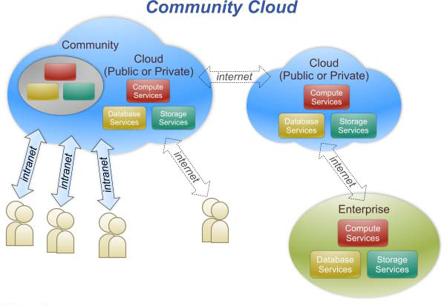
Community Cloud
The cloud infrastructure is shared by several organizations and supports a specific community that has shared concerns (e.g., mission, security requirements, policy, and compliance considerations).

Slide 37
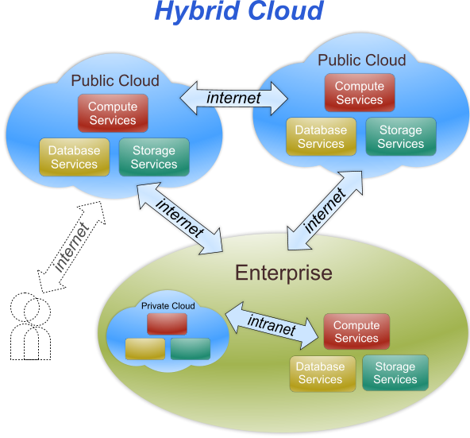
Hybrid Cloud
The cloud infrastructure is a composition of two or more clouds (private, community, or public) that remain unique entities but are bound together by standardized or proprietary technology that enables data and application portability (e.g., cloud bursting for load-balancing between clouds).

Slide 38
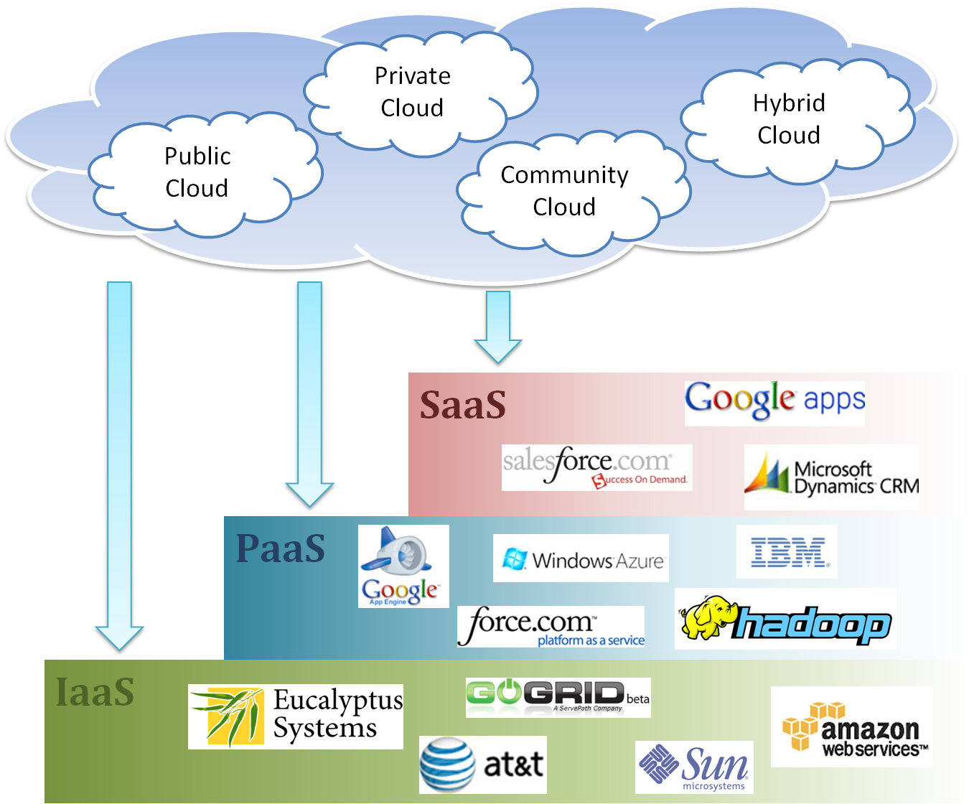
Cloud Ecosystem

Slide 39
Real Scenario of Resource Provisioning
Service Provider’s viewpoint

Slide 40
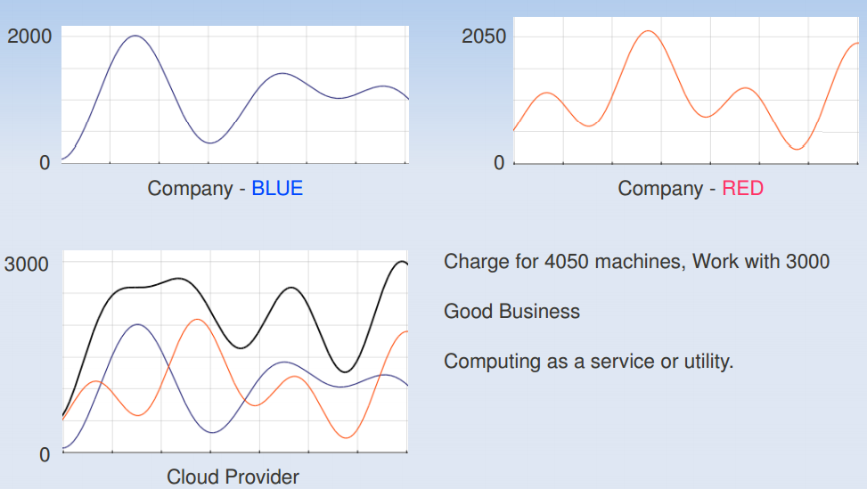
Resource Provisioning – CSP’s View

Slide 41
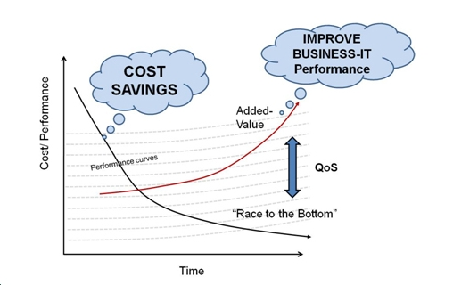
Race to the Bottom versus QoS
Image Source: http://www.opengroup.org/cloud/whitepapers/ccroi/intro.htm

Slide 42

Race to the Bottom versus QoS
The terms “race to the bottom” refer to the competing drive between participants in a market driven by the need to make the greatest cost savings i.e., highest profit.
Quality of Service (QoS)…..that you promise to your customers
May loose customers if failed to maintain QoS
Can you compromise with QoS?
What is the relation between Cost and QoS?
Simple assumption ….customer may pay more for good QoS
Service provider can earn more profit …… ☺
Customer gets good QoS ….. ☺
Customer has to pay more….☹
So is there any scope to make both of them happy?

Slide 43
Cloud Service Broker
A new entity in the cloud ecosystem

Slide 44

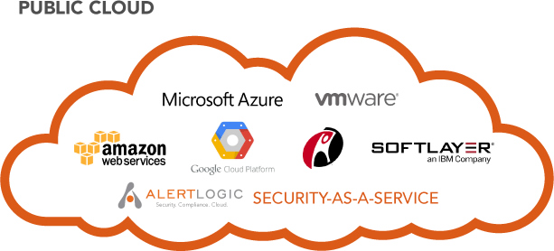


Cloud Service Broker
Cloud Service Broker
Cloud User
Cloud Service Providers
Cloud Service Broker (CSB) can help cloud user to select best fitting Cloud Service Providers (CSPs), who can provide best quality resources at negotiated price.

Slide 45
Responsibilities
Selection of suitable service provider…. Price vs QoS
Price Negotiation
Service Level Agreements (SLAs)
Management of demand (request) and Supply (services) ….. How to manage spikes in resource demand while satisfying the SLAs?
Monitoring
Resource utilization ….over utilized or under utilized
SLA….. If there is any SLA violation

Slide 46
Demand versus Supply
Heavy demand or No demand ☹

Slide 47
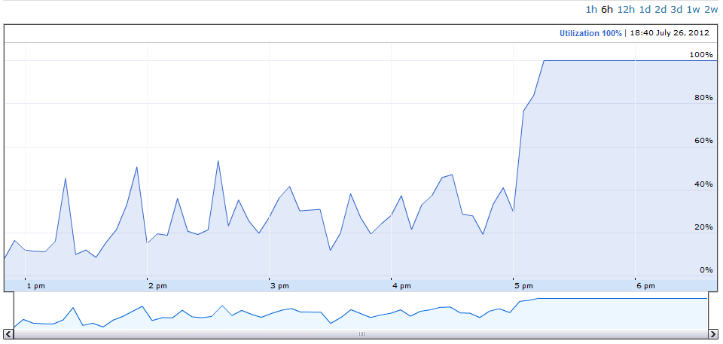
Service Provider- utilization

Slide 48
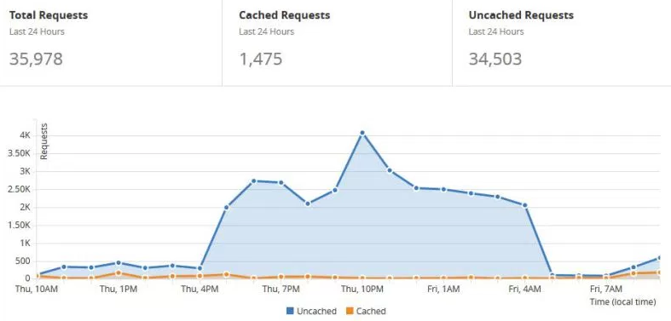
Spikes in requests

Slide 49
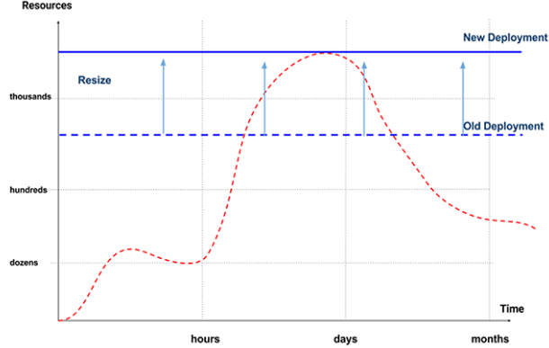
Scale-up

Slide 50
Available resources are not Sufficient
……may loose some customers at peak

Slide 51
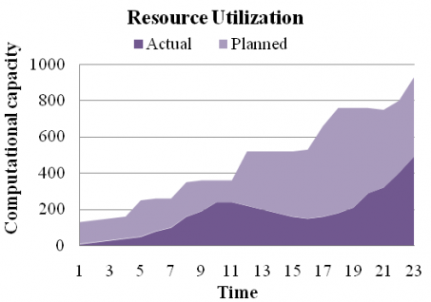
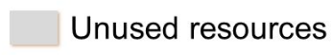
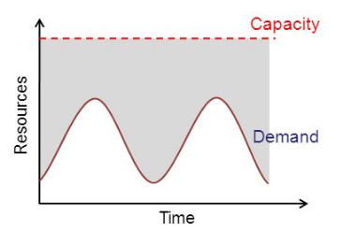
Under utilization

Slide 52
resources are under utilized
……may earn more if get a chance

Slide 53
Small and mid-sized CSPs
Infrastructure constraint
Scaling issues
Budget constraint
….. not able to maintain good QoS, especially while competing with market giant like Amazon

Slide 54
Cloud Federation
Scenario 1: High demand … over utilized …more resources will be better
Scenario 2: Low demand … under utilized …more requests will be better
Let’s collaborate..☺

Slide 55
Cloud Federation
Cloud Service Broker
Cloud Users
Cloud Federation
Federating cloud resources can be a solution for interoperability among multiple clouds, enabling the formation of a pool of resources used for providing on demand services.

